Slide 1
Packaging Overview​
Maria Kreml, Packaging Specialist​
November 5, 2024

Slide 2
TKO Seminar November 5, 2024: Packaging Overview
Protecting Spare Parts in the DoD Supply Chain
To provide DLA contractors with a brief overview of the contractual packaging and marking requirements. Cover key topics to successfully understand and execute these essential requirements. Provide basic information to navigate through mandatory documents and meet DLA packaging, marking, and barcoding expectations, contractual obligations, and ultimately supporting our troops with superior seamless support.
Information to properly execute Contractual Packaging, Marking, and Barcoding Requirements.
Decoding packaging data, Preservation Methods, Quantity Unit Pack (QUP)), Intermediate Container Quantity (ICQ)
Overview of: MIL-STD-2073-1E, ASTM D3951, MIL-STD-129R, ISPM 15, J-STD-609, hazardous materials, and Reports of Discrepancies
Resources for further assistance

Slide 3

Packaging Overview
TKO Seminar
FOCUS: Defines DLA Field Activities responsibilities concerning the packaging of DLA managed material, to be procured, stored, and shipped with adequate, continuous protection at the lowest overall cost.
EXPECTED RESULTS: Material is procured fully packaged and marked in a ready-for-issue state. Products must arrive at ultimate consignee’s (user) designation in serviceable condition.
INNOVATION: Contractors are encouraged to use state-of-the-art materials, processes, and equipment in accordance with contract requirements.
Defense Logistics Agency
Packaging Program

Slide 4
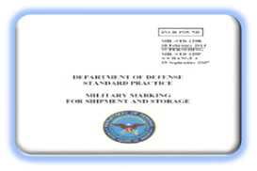

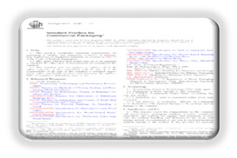
Packaging Overview
TKO Seminar
Contractual Preservation, Packaging, Packing, and Marking Standards
MIL-STD-2073-1E: Standard Practice for Military Packaging
Decodes preservation, packaging, packing, and special marking requirements Appendix J denotes packaging data
Required for long-term storage and/or items with specific protection needs that cannot be met with commercial practices
Free document to download
NOTE: If packaging data is missing, review paragraph 4.2 and notify contracting officer
MIL-STD-129R: Military Marking for Shipment and Storage
Department of Defense uniformed marking requirements
Mandatory marking requirements for ALL DoD shipments to identify material and trace back to
the contractor
Free document to download
NOTE: Review pictorial marking requirements within ASTM D5445 when special markings required.
ASTM D3951:Standard Practice for Commercial Packaging
Establishes minimum requirements for packaging of supplies and equipment
Package design must facilitate multiple handling, shipment by any mode, and storage for minimum of one year in enclosed facility
without damage to the product.
Unit package must also be ready for issue and redistribution without any additional packaging and/or marking.
Copyright protected – must purchase this document
NOTE: Only applicable when an acquisition document references this document solely.
Either
Always

Slide 5
Packaging Overview
TKO Seminar
MIL-STD-2073-1E
Development of codes are determined by item characteristics (e.g., physical, chemical, fragility factor, destination considerations, etc.)
Information contained on solicitations and awards specifying the packaging coded data required to protect item throughout the life cycle (Section B on solicitations and awards)
Coded packaging data is for the items going into the Military Distribution Cycle that are required to protect parts for world-wide shipment, long-term storage, and against severe environmental conditions (e.g., extreme climate, terrain, operational, and transportation environments)
WHY?

Slide 6
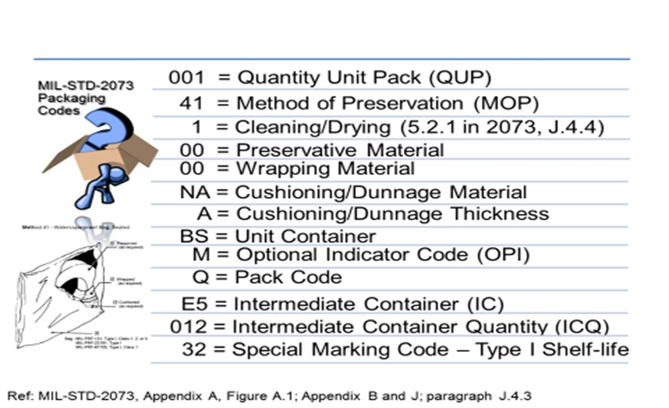
Packaging Overview
TKO Seminar
Example of MIL-STD-2073-1E Coded Packaging Data Requirements

Slide 7
Packaging Overview
TKO Seminar
Unit of Issue and QUP: How it Appears on DLA Contracts
Unit of Issue (UI) is located within the Contract, Section B
CLIN
1
PR PRLI
0040888212 0001
UI
PR
Quantity
15
Unit Price
$113.05
Total Price
$1695.75
QUP & Packaging Data are located in the Contract, Section B under PREP FOR DELIVERY PKG DATA – MIL-STD-2073-1E, DATED 23 May 2008
QUP= 001; PRES MTHD = 41; CLNG/DRY = 1; PRES MAT = 00; WRAP MAT = 00; CUSH/DUNN MAT = NA; CUSH/DUNN THCK = A; UNIT CONT = BS; OPI = M; INTERMDTE CONT = E5; INTERMDTE CONT QTY = 012; PACK CODE = Q
MARKING SHALL BE IN ACCORDANCE WITH MIL-STD-129.
SPECIAL MARKING CODE: 32 (TYPE 1 SHELF LIFE)
PALLETIZATION SHALL BE IN ACCORDANCE WITH RP001: DLA Packaging Requirements for Procurement
TIP: Pay close attention to QUP and UI lines on the contract. This QUP and Unit of Issue must be marked as: 1 PR for all unit containers.

Slide 8
Packaging Overview
TKO Seminar
Five Basic Methods of Preservation of MIL-STD-2073-1E
10
Physical and Mechanical Protection
20
Preservative Coating Requirement
30
40
50
Attention: As the numeric value increases, so does level of preservation increase.
Waterproof or Greaseproof Protection
Watervaporproof Protection
Watervaporproof Protection with Desiccant

Slide 9
Packaging Overview
TKO Seminar
Submethods: Methods of Preservation of MIL-STD-2073-1E
30 – Waterproof protection
31 – Waterproof bag, heat sealed
32 – Container, waterproof bag
33 – Greaseproof-waterproof bag, heat sealed
40 – Watervaporproof protection
41 – Watervaporproof bag, heat sealed
42 – Container, watervaporproof bag, heat sealed, container
43 – Floating watervaporproof bag, heat sealed
44 – Rigid container (other than metal), sealed
45 – Rigid metal container, sealed
50 – Watervaporproof protection with desiccant
51 – Watervaporproof bag, heat sealed, with desiccant
52 – Container, watervaporproof bag, heat sealed, container, with desiccant
53 – Floating watervaporproof bag, heat sealed, with desiccant
54 – Rigid container (other than metal), sealed, with desiccant
55 – Rigid metal container, sealed, with desiccant
Attention: As the numeric value increases, so does level of preservation increase.

Slide 10
Packaging Overview
TKO Seminar
Examples: MIL-STD-2073-1E Specialized Method of Preservation
GX
Denotes part is Electrostatic Sensitive Discharge (ESD) and/or susceptible to Electromagnetic Interference (EMI)
Requires ESD Control Program
HM
Denotes regulated by transportation as a hazardous material
Packaging and marking in accordance with Hazardous Materials regulations
ZZ
Requires item shall be handled at ESD workstation
Shall only use “Approved” ESD packaging materials by “Qualified” Sources
Requires ESD labeling for users to be aware of special handling requirements
Failure to comply with “GX” requirements can cause intermittent failures, permanent operational failures, or latent failures
Compromised parts (parts exposed to ESD shall be returned to the contractor).
Performance-Oriented Packaging (POP) certified containers
ATTENTION: Packers shall be trained and certified to package, mark, label, placard hazardous materials and certify shipping papers per Title 49 code of Federal Regulations (CFR).
Denotes special requirements exist
Must have reference information within the contract’s supplemental packaging instructions
May refer to either special packaging instruction, or kit packaging, or military standard.
If “ZZ” reference is missing on your acquisition document, please consult your contracting officer for assistance (see MIL-STD-2073-1E, paragraph 4.2 for proper procedure)
ATTENTION: Packagers and handlers must be trained to comply with ESD Control Program.
Do not attempt to supply to DLA if untrained or not certified for penalties of fines and/or jail.

Slide 11
Packaging Overview
TKO Seminar
Quantity Unit Pack
Intermediate Container Quantity
Factors for Determining Military Packaging Quantity Unit Pack (QUP):
QUP of one:
  Repairable items, valued $50 or more
  Items packed in accordance with Method of Preservation 50, irregular shaped, delicate or fragile items
  Items with a unit of issue of pair (PR), set (SE), or kit (KT) (see paragraph B.3.1 – B.3.6)
QUP more than one:
  Formulas based upon item weight, dimensions, cost, and method of preservation (see paragraphs B.3.8 – B.3.8.2 and Table B.4.1 or B.4.2)
Determining Quantities per Intermediate Container Quantity (ICQ):
ICQ Maximums:
  100 unit packs per intermediate container
  40 pounds
  1.5 cubic feet with at least two dimensions not exceeding 16 inches
  If ICQ code is “AAA” then go to MIL-STD-2073-1E, Appendix B, Table B.I to determine quantity
Intermediate Container Limitations
  When quantity shipped to a single destination is less than the established ICQ, then place all unit packs in a minimum size shipping container
  When the contract/order total quantity is more than established ICQ pack as many intermediate containers to the established ICQ and the remaining quantity in smallest container to accommodate these unit packs

Slide 12
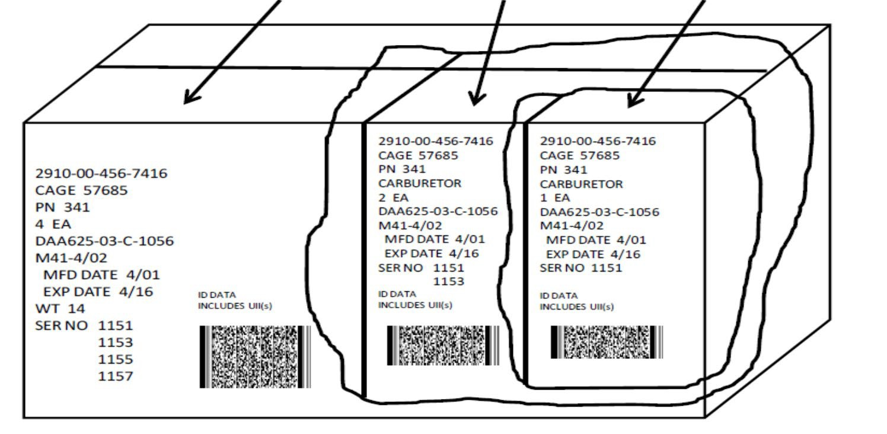
Packaging Overview
TKO Seminar
MIL-STD-129 Marking and Bar Code Examples
EXTERIOR CONTAINER
INTERMEDIATE CONTAINER
UNIT PACK
No Nomenclature, unless the product is a regulated hazardous material, then Proper Shipping Name required on the exterior/shipping container.

Slide 13


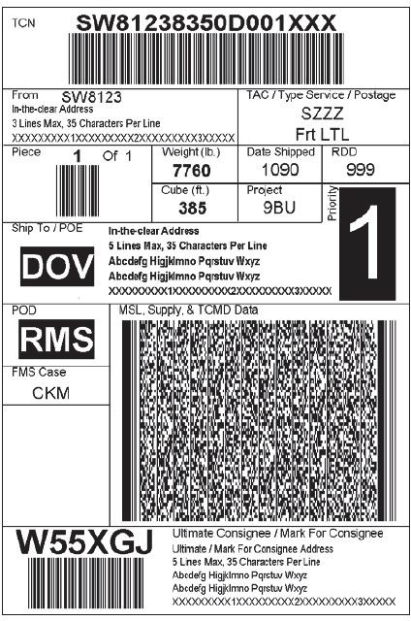





Packaging Overview
TKO Seminar
The recommended MSL size is 4 by 6 inches
Code 39 (Linear)
  TCN (Transportation Control Number)
Piece number
Ultimate consignee
Department of Defense Activity Address Code (DODAAC) PDF417 (2D)
Shipment
Line item
Transportation Control Movement Document (TCMD) date
Transportation Office:
  1-800-456-5567
  delivery@dla.mil
Code 39: formatted in accordance with MIL-STD-129 in reference to ISO/IEC 16388.
2D: See ANSI MH10.8.1 and ISO/IEC 15438, formatted in accordance with 5.2.2.6 and Appendix A of MIL-STD-129

Slide 14
Packaging Overview
TKO Seminar
ASTM D3951: Standard Practice for Commercial Packaging
Allows for selected items to be packaged in accordance with ASTM D3951, Standard Practice for Commercial Packaging. This requirement must be explicitly cited within your acquisition document to utilize it:
  Commercial Packaging QUP:
  ASTM D3951, paragraph 5.1.2.2 governs Unit Package Quantity
  Contract QUP takes precedence over ASTM D3951
  Typically, QUP 001 unless otherwise specified within your contract
Commercial Packaging ICQ:
  ASTM D3951, paragraph 5.1.3 governs intermediate package quantity
Commercial Packaging “Marking”:
  ASTM D3951. paragraph 5.1.6.5 governs markings for DoD shipments (required to use MIL-STD-129)
  Method of Pack mark for commercial packaging: required to leave blank per MIL-STD-129, paragraph 5.1.1.g (only PACK Date entry required on this line)
  Bar code - 2D barcode (PDF417) is in accordance with ANSI MH10.8.1 and ISO/IEC 15438
Minimum Package Design Requirements are listed in ASTM D3951, paragraph 5.
Packaging shall be capable of successfully passing the test levels of Practice D4169 Distribution Cycle 18 for shipments destined for delivery to the Department of Defense.
Wood Packaging Material (WPM)
  ASTM D3951, paragraph 5.1.6.4 governs compliance with ISPM Publication No. 15

Slide 15

Packaging Overview
TKO Seminar
Palletization Clause in DLA Master List of Technical Quality Requirements, RP001
Why ISPM for WPM?
  To help reduce the risk of pest infestation, a global set of measures has been accepted and are applied to WPM.
  Ensure WPM is in conformance with the International Standards of Phytosanitary Measures Publication No. 15 (ISPM 15). We work together to ensure global environmental measures are adhered for the welfare of forests.
  Per DoD4140.65M, WPM must be stamped or branded with the appropriate certification markings as detailed in DODM 4140.65 and be certified by an accredited American Lumber Standards Committee (ALSC)-recognized agency. The WPM certification markings must be easily visible, especially in pallet loads for inspectors to conduct visual inspections. ISPM 15 certification marks must be visible at all times even if strapping is applied. Shipments are inspected and audited for compliance.
Requirement:
  Heat-treated wood requirements in accordance with DLA contract clause
  52.247-9012 Requirements for Treatment of Wood Packaging Material (WPM) (9/2016)
  Applies to wood packaging material used to fabricate crates, boxes, and pallets.
  WPM is also cited in DLA Master List of Technical Quality Requirements: RP001 and applied to all DLA contracts.
  ALL WPM shall be heat-treated, including pallets, and marked accordingly with the heat-treated compliant mark.
  ISPM 15 HT stamp, stencil, or branded directly into WPM with contrasting color (red and orange are not authorized).
  Mark shall not be hand drawn.
  HT stamp must be visible on exterior of container or pallet and HT stamp must be legible, durable, non-transferable, and placed on at least two opposite sides of wood packaging unit – pallet load, box, or crate.
  Non-compliant shipments will result in frustrated shipments and contractor’s receiving supply discrepancy reports.
Level A Packing: Pallets shall utilize ANSI/MHIA-MH1, Part No. MH 1/9-05SW4048 distributed.
Level B Packing: Pallets shall utilize ANSI/MHIA-MH1, Part No. MH 1/9-02SW4048 pallet for unit loads less than 1500 lbs. evenly distributed. For unit loads greater than 1500 lbs., but less than 3000 lbs. evenly distributed, ANSI/MHIA-MH1, Part No. MH1/9-05SW4048 pallet shall be utilized.
NOTE: Failure to comply may result in frustrated cargo and delayed payments. Contractor shall be responsible to pay for expenses to remedy non-compliant WPM. UN countries strictly enforce this requirement.

Slide 16
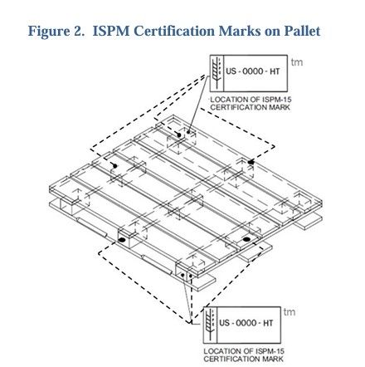
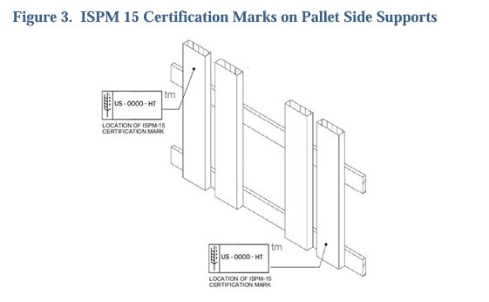
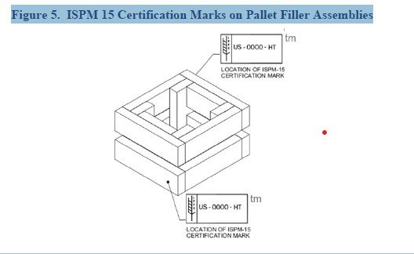
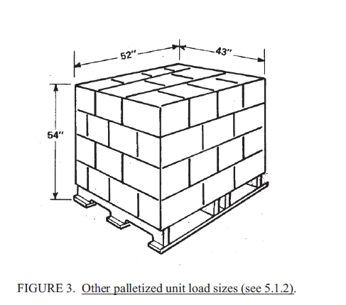
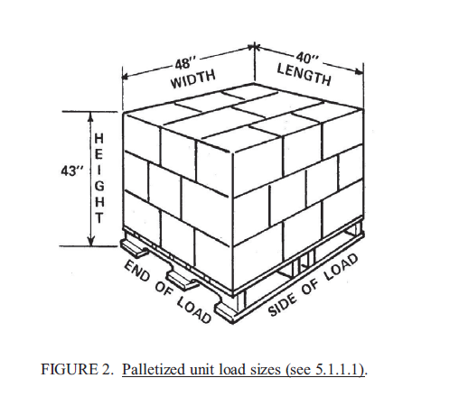
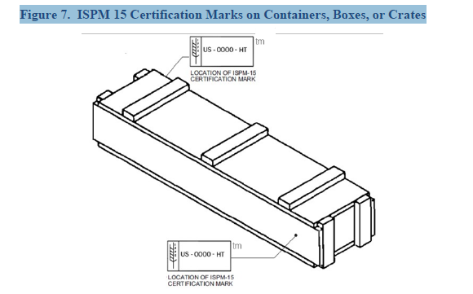
Packaging Overview
TKO Seminar
WPM ISPM 15 HT Stamp Locations and Loaded Pallets IAW MIL-STD-147

Slide 17






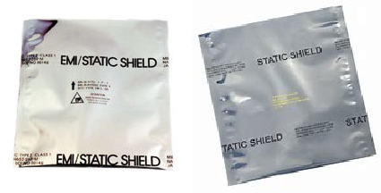
Packaging Overview
TKO Seminar
Electrostatic Discharge (ESD) Protection Requirements
Cushioning: Four Choices –
  A-A-3129, Type I, Grade B; or
  PPP-C-795, Class 2; or
  A-A-59135, Class 1, Grade B; or
  PPP-C-1797, Type II
Wrap: use MIL-PRF-81705, Type III
NOTE: Type II is no longer used
Unit Container (Barrier): MIL-DTL-117, Type I, Class F, Style 1 (MIL-PRF- 81705, Type I, Class 1)
NOTE: Some packaging codes require both bag and box to make a unit package. Both containers must have the same markings.
Qualified Products List (QPL)
Type I: Cadillac Products Packaging Co. (CADPAK ESD)/EDCO or Covalence Specialty Marked: EMI/STATIC SHIELD
Type III: Caltex Plastics (CP STAT 100M) is the only MIL-PRF-81705, Type III qualified manufacturer. Marked: STATIC SHIELD
Beware of non-approved material (see MIL- PRF-81705 for all require barrier markings)
Check ASSIST Quick Search for QPLs at: https://quicksearch.dla.mil

Slide 18





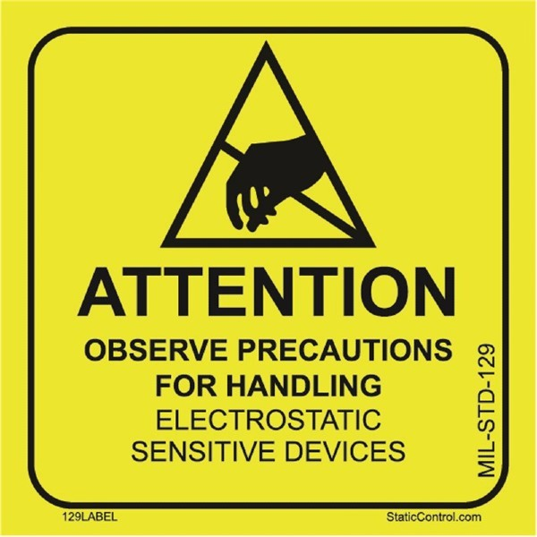
Packaging Overview
TKO Seminar
Electrostatic Discharge (ESD) Protection Requirements (continued)
39 - ESD Sensitive Device
requirements of MIL-STD-129 apply
ATTENTION:
Required label for unit packs
ATTENTION:
Required label for exterior and intermediate containers
This item requires DoD Qualified Electrostatic Discharge (ESD) protective packaging materials in accordance with MIL-PRF-81705. The supplier shall be responsible for verifying that all MIL-PRF-81705 barrier materials (or converted bags) are supplied from a qualified manufacturer currently listed on QPL-81705.
For additional ESD packaging information, refer to the following DLA packaging web site:
https://www.dla.mil/HQ/LogisticsOperations/P ackaging/PackFAQs/ESDS/

Slide 19
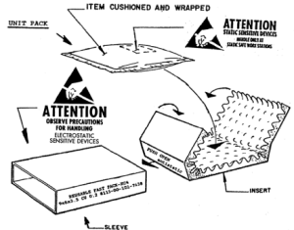
Packaging Overview
TKO Seminar
EXAMPLES: Electrostatic Discharge (ESD) Protection Requirements
ESD sensitive devices must be handled ONLY at STATIC SAFE workstations.
ATTENTION OBSERVE PRECAUTIONS FOR HANDLING ELECTROSTATIC DISCHARGE SENSITIVE DEVICES”.

Slide 20
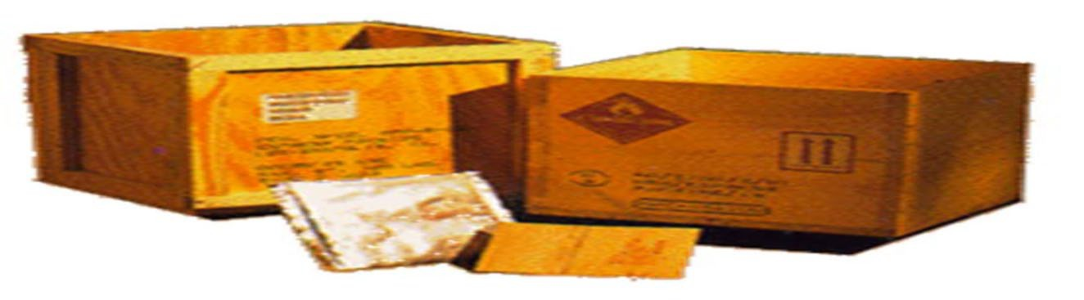
Packaging Overview
TKO Seminar
Hazardous Materials Regulations
LAND: Title 49 Code of Federal Regulations (CFR)
WATER: IMO/IMDG
COMMERCIAL AIR: ICAO/ IATA
MILITARY AIR: AFMAN 24-204_IP*
  Must be marked and labeled IAW latest MIL-STD-129 in addition to the required hazardous material markings
  DLA Master List of Technical Quality Requirements, IP025 Packaging, Marking, and Shipping of Hazardous Materials
  ATTENTION: All packers must be trained and certified to package, pack, mark, label, placard, and complete applicable documentation per Title 49 CFR.

Slide 21
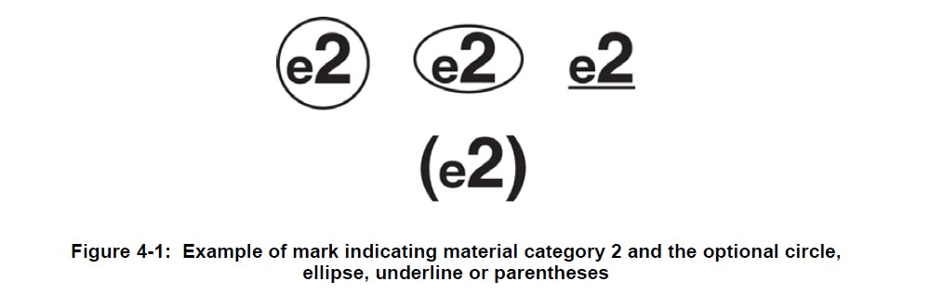
Packaging Overview
TKO Seminar
J-STD-609 E-code Markings
E-code Example Marking/Labeling Categories
Pb-containing
e0: contains Pb2
Pb-Free
e1: tin-silver-copper
e2: tin alloys (Sn)
e3: tin (Sn)
Legislation
Reference: IPC/JEDEC J-STD-609
Federal Supply Classes (FSCs): 5905, 5910, 5945, 5961, and 5962
drove electronics industry toward the use of lead-free (Pb-free) solders and components with PB-free level termination finished and materials.
Marking and Labeling of Components, PCBs and PCBAs to identify Lead (Pb), Pb-Free and Other Attributes
Adopted by DoD on January 9, 2008
Required to identify the type of Pb-free and Pb-containing solders and finishes of components, assemblies/boards, interconnect terminal finishes and materials. Apply e-code to unit container label.
Devices must be tested to determine material composition and to apply applicable e-code.
DLA has Quality Assurance procedures to ensure e-codes applied are correct.
e4: precious metal
e5: tin-zinc (SnZn)
e6: bismuth (Bi)
e7: low temperature solder
e8: tin-silver cooper (SnAgCu)
For informational purposes only

Slide 22
Packaging Overview
TKO Seminar
Reports of Discrepancies
Common Types of Non-Compliances:
Heat-treated wood requirements – all wood products used
Not in accordance with DLA Master List of Technical Quality Requirements, RP001 – Requirements for Treatment of Wood Packaging Material (WPM) (latest revision).
WPM (including pallets)is not heat treated and marked in accordance with the heat-treated compliant mark, ISPM 15 or STAMP is not visible for inspector to verify compliance.
ESD parts not packaged in compliance with Method of Preservation “GX”
  Not packaged in DoD approved packaging materials by qualified manufacturers
  Missing wrapping or cushioning material (one or the other must be inside the barrier bag)
  Part punctured through barrier bag
  Tape, staples, paper, or rubber bands inside barrier bag
  Barrier bag not sealed
Marking problems (most documented errors)
  Any elements of MIL-STD-129 omitted
  Incorrectly labeled
  Not bar-coded
  Omission of e-code, shelf-life, or lot date code when cited in the contract, specification, standard, or drawing
Preservation and Packing non-conformances
  No contractual authorization to substitute ASTM D3951 for military method of preservation (MOP)
  Used Incorrect Method of Preservation (e.g. MOP 31 when MOP 41 called out in contract)
  Container oversized, stacking strength not adequate, damaged shipments
67%
Marking
10%
ESD
10%
WPM
13%
Packing
Preservation

Slide 23
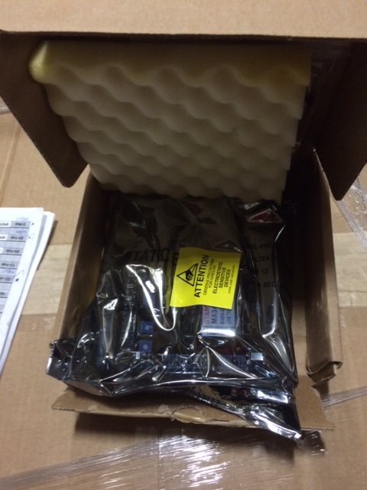
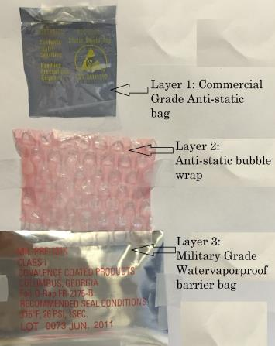
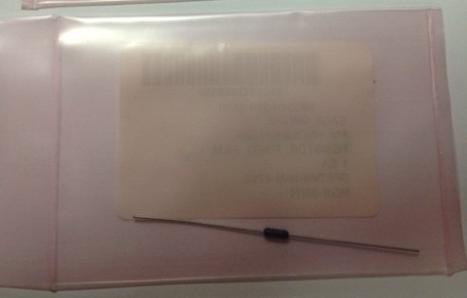
Packaging Overview
TKO Seminar
Samples of ESD Discrepancies
Remember: Method of preservation “GX” is a package design system. Your package design must meet all the requirements to be compliant.
Wrapping and Barrier materials are incorrect.
MIL-PRF-131 does NOT have any electrostatic protective characteristics, only has watervaporproof protection.
Always review the spec.!
Barrier material is incorrect. Does not meet MOP “GX” requirement – MIL-PRF-81705, Type I. Also requires at least a wrap to ensure protection when handled by customer.
NOTE: The barrier material shall have these markings for inspection purposes.
No Cushioning material inside barrier bag. Sharp protrusions from soldered parts can puncture barrier bag and compromise ESD sensitive component and permanently damage the part.

Slide 24
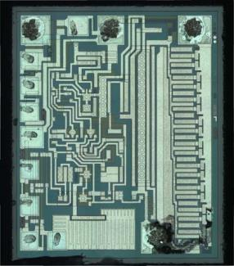
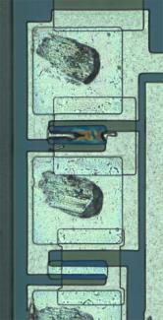
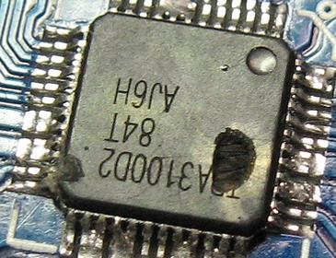
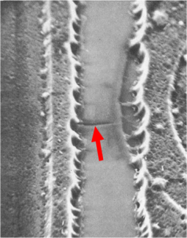
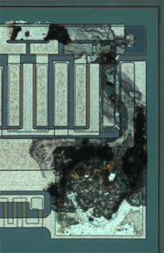
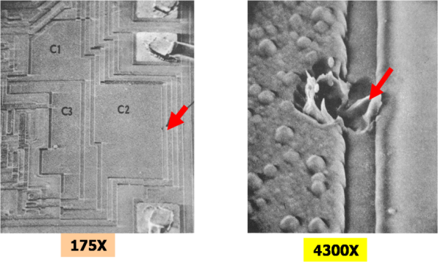
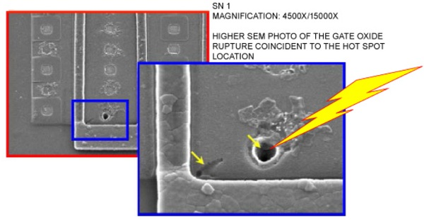
Packaging Overview
TKO Seminar
Samples of Parts Damaged by Electrostatic Discharges NOTE: Red arrows show where electrostatic discharge took place on the parts.
Ref: Academy of Aerospace Quality (AAQ), http://aaq.auburn.edu/node/276

Slide 25

Packaging Overview
TKO Seminar
Thomas Register: List of “Packaging Houses”
(DLA legally cannot endorse any specific “packaging house”) https://www.thomasnet.com/prodsearch.html?cov=NA&which=prod&what=Military+Packaging+ houses&navsec=search
ASSIST Quick Search
ASSIST is the official source for specifications and standards used by the Department of Defense https://quicksearch.dla.mil
American Lumber Standard Committee (ALSC)
Wood Packaging Material (WPM) Accredited Agencies https://www.alsc.org/WPM_summary_mod.htm
Association of Procurement Technical Acquisition Centers (APTAC)
Local one-on-one government contracting assistance
https://aptac.org
Joint Electron Device Engineering Council (JEDEC)
  The technical voice of the semiconductor industry
  https://www.jedec.org
National Institute of Packaging, Handling & Logistics Engineers (NIPHLE)
https://niphle.com
DLA Packaging Web Site
https://www.dla.mil/Logistics-Operations/Packaging/
R
E
S
O
U
R
C
E
S

Slide 26
Questions

Slide 27
Thank you for collaborating with us to support our troops world-wide missions.

